Slide 1




Large
Scale Drupal
at the University of Oregon
Notes:
Welcome to Large Scale Drupal at the University of Oregon.
My name is Vid Rowan and I work in Human Resources at the University of Oregon. We hope you are in the right room.
Show of hands
Work in Higher Ed, Non-Profit, Govt.? Or work in a decentralized environment
Lots of developers doing the same kind of work - Every developer for themselves?!
Familiar with Aegir?
Interest in deploying a 100+ sites with an efficient route for updates, sharing resources, connecting test, stage and prod environments?
Next Slide

Slide 2

The Problem
A department hosts their own website on aging hardware in some dusty closet and administers it on their own, effectively on an island.

Slide 3
The Problem
A department hosts their own website on aging hardware in some dusty closet and administers it on their own, effectively on an island.*
(* this times, say, 20)

Slide 4
The Problem
A department hosts their own website on aging hardware in some dusty closet and administers it on their own, effectively on an island.*
(* this times, say, 20)
… or 30? 40? we have no idea how bad the situation actually is due to a legacy of decentralized IT.

Slide 5
The Problem
This is inefficient, in every sense of the word.
No shared virtual/physical resources
No shared codebases
No shared staff (devs & sys admins)
... but everyone is trying to accomplish similar goals.
Notes:
Decentralized staffing means siloed/solo developers trying to build websites with the best available resources/knowledge they have.
Developers in silos aren’t working together - no cooperation or consensus.

Slide 6

The Service Need
We need a centrally managed way to host a wide range of Drupal sites.

Slide 7
The Service Need
We need a centrally managed way to host a wide range of Drupal sites.
(*this wasn’t actually his idea)

Slide 8
The Service Need
We need a centrally managed way to host a wide range of Drupal sites.
Move everyone into the same environment, encourage staff to utilize the same tools
Eliminate redundant VMs and aging hardware
Make it easier for central Information Services to administer/monitor servers
(*this wasn’t actually his idea)

Slide 9
The Problem, Pt. II

Slide 10
The Problem, Pt. II
The Reproblemming

Slide 11
The Problem, Pt. II
The Reproblemming
Fixing this is not an institutional priority,
so we’re not going to get upfront resources.

Slide 12
The Problem, Pt. II
The Reproblemming
Fixing this is not an institutional priority,
so we’re not going to get upfront resources.
(random find from a Google image search for “frustrated” here)

Slide 13
The Problem, Pt. II
The Reproblemming
Fixing this is not an institutional priority,
so we’re not going to get upfront resources.
(random find from a Google image search for “frustrated” here)
Departments/staff are used to getting things their way. (Heavy flexibility/customization burden)

Slide 14
The Problem, Pt. II
The Reproblemming
Fixing this is not an institutional priority,
so we’re not going to get upfront resources.
(random find from a Google image search for “frustrated” here)
Departments/staff are used to getting things their way. (Heavy flexibility/customization burden)
We will have to solve this on our own.

Slide 15
Why solve this on our own?
We have to build it first to prove that it’s a viable solution
Wanted full control and ability to customize.
  We don’t know what we need, so we need to be able to adapt as we go.
2 other Aegir instances already in use on campus.
  Our expectation was that it would be easier to migrate them into a similar system.
Notes:
Daniel
If there’s buy-in then eventually we have a case for ‘centralized’ funding and support.
The cost / benefit analysis is based on real data and not projections
Next Slide

Slide 16
Our Implementation
Aegir hosting system
  Provision
  Hostmaster
  Contrib modules
  Custom modules/drush commands
Site Build Workflow
  Drush
  Git
  Staging to Production
Notes:
Daniel
Trigger demo.
We’re using Aegir, which consists of two major pieces - Provision and Hostmaster. Provision is a set of drush extensions that manages your behind the scenes server work - Hostmaster is itself a Drupal 6 site that gives you a UI to manage your sites. In addition, we’re using a host of contrib modules, as well as quite a few custom modules.
Most of our custom modules were written to add access control - Aegir doesn’t work as a multi-tenant, multi-admin system out of the box, so we had to rework it pretty heavily to make sure that users in Hostmaster couldn’t accidentally mess with each other’s stuff.
Clients - We assign developers to “Client” groups in Aegir.
Platform vs. site - Each platform that is created can be assigned to one or many clients. Each site that is created is assigned to one client. This allows platforms to be shared with other groups but still keep the site separate.
Makefile and git - Each platform is created using a drush makefile. Makefiles include d.o modules/themes, custom modules/themes/libraries from various sources including our local git installation (stash). We also support sites in platforms that can use git to have local modules/themes/libraries that are site specific. This feature goes with the idea of sharing platforms but still having the option to customize individual sites.
Staging to Production
We initially started with a test Aegir instance to onboard developers. Onboarding included helping users convert their Drupal sites from single installations to platform based, setting up makefiles, using git, and migrating the site into Aegir which included helping users migrate the database and files. We did this on the test Aegir instance which is now a staging cluster on the same Aegir installation instead of separate ones. The test/stage Aegir instance is a safe place for developers to get familiar with the Aegir workflow, experiment with their site in Aegir and so on. Side note: the test/stage Aegir is limited to campus.
Once a site is moved into test the process had to be repeated on production. We replaced the “test” Aegir with a stage cluster on the same Aegir instance as production. This allowed the same workflow with going live being only a clone.
Next Slide

Slide 17
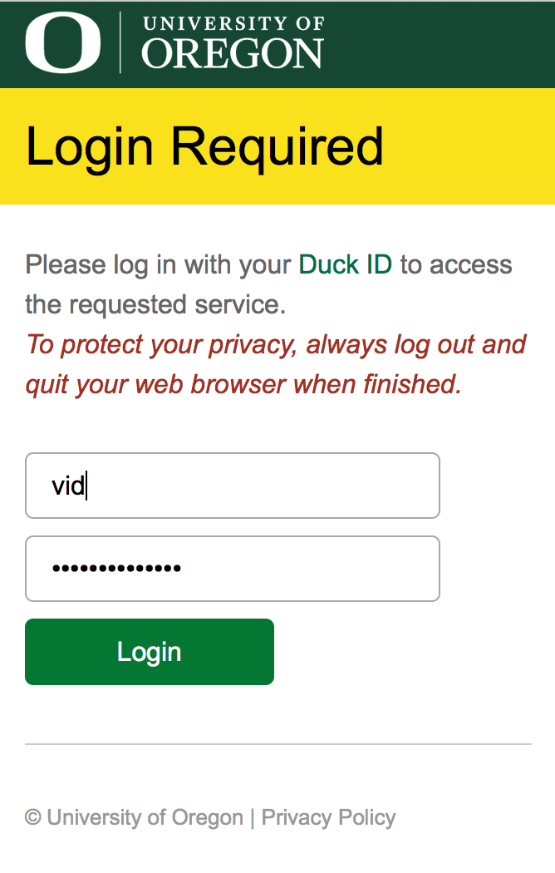

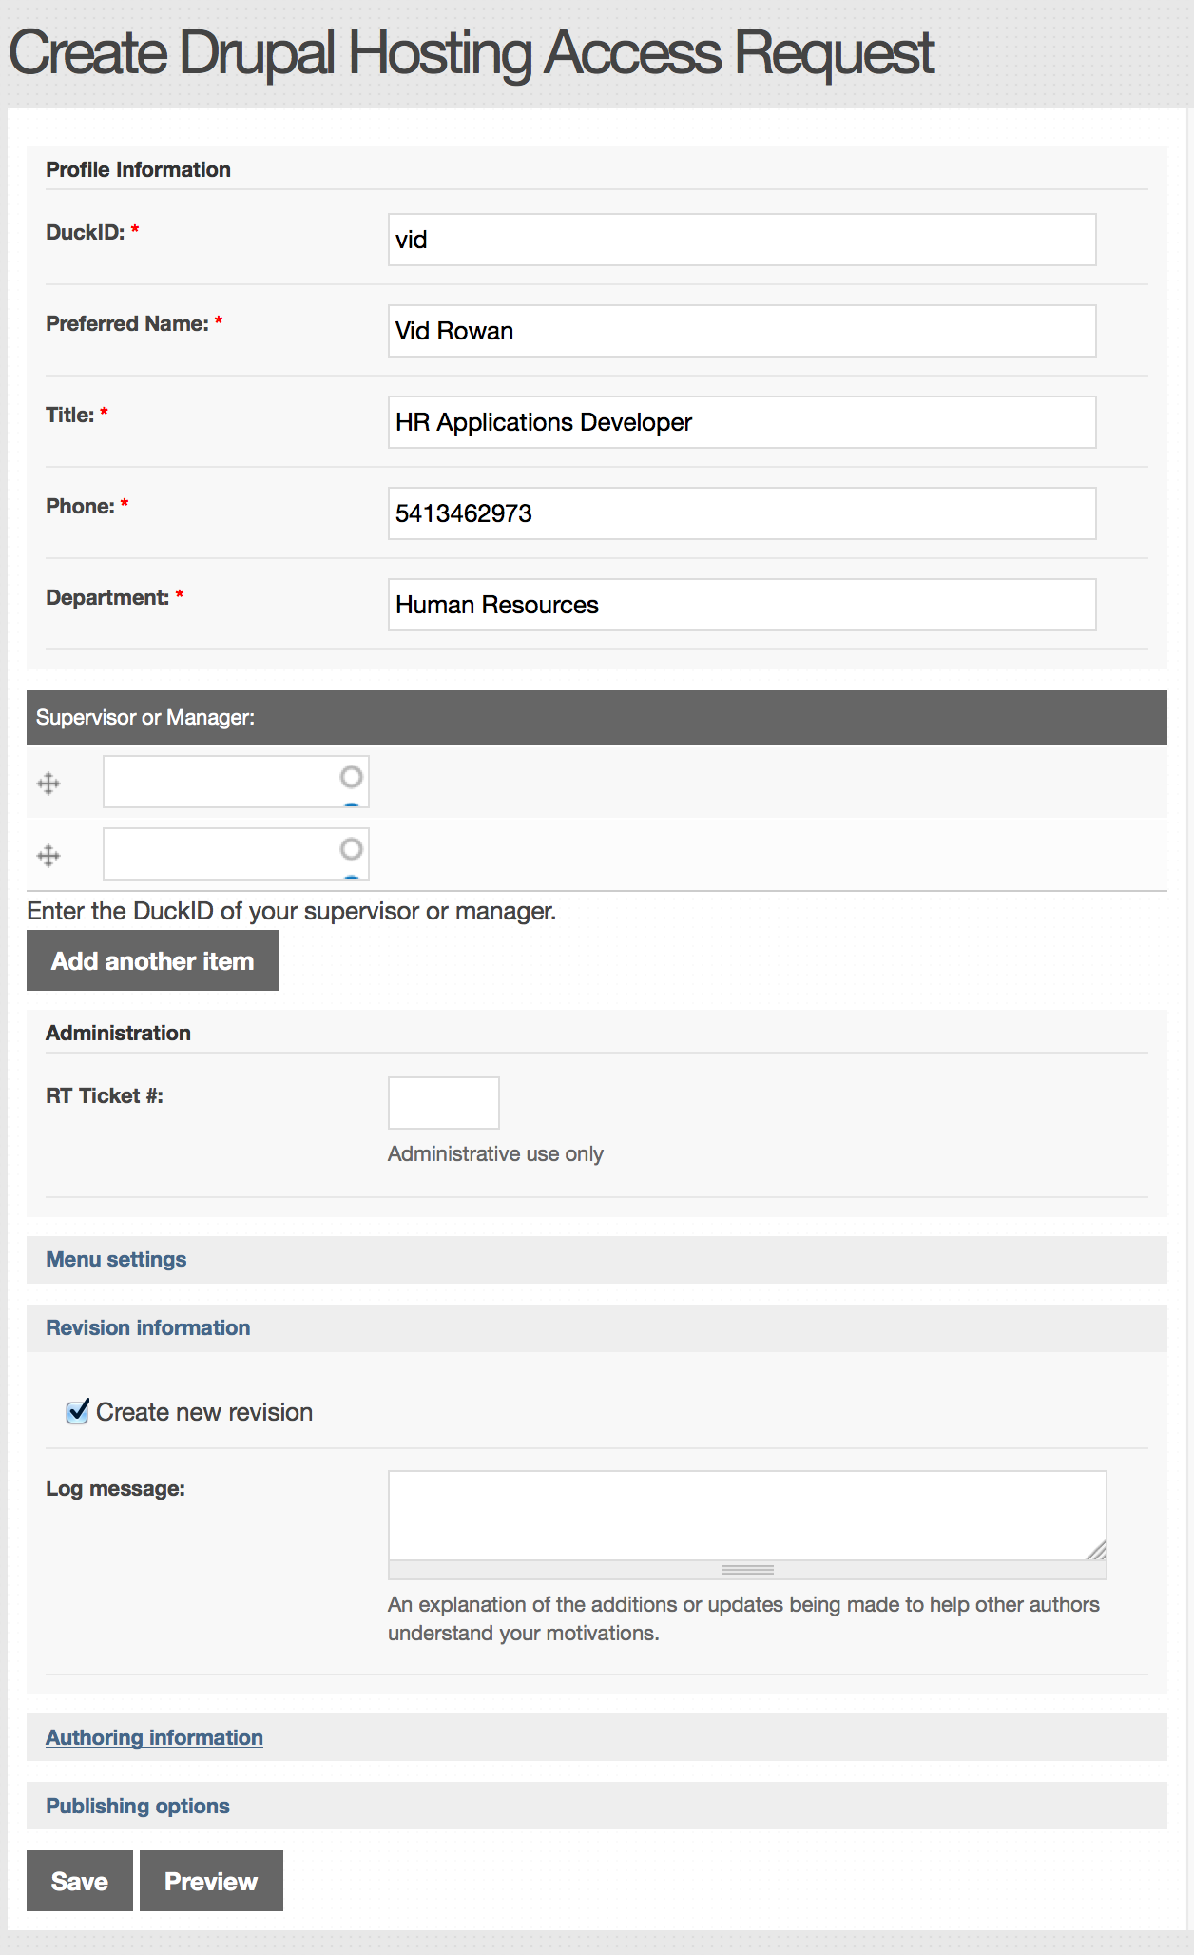
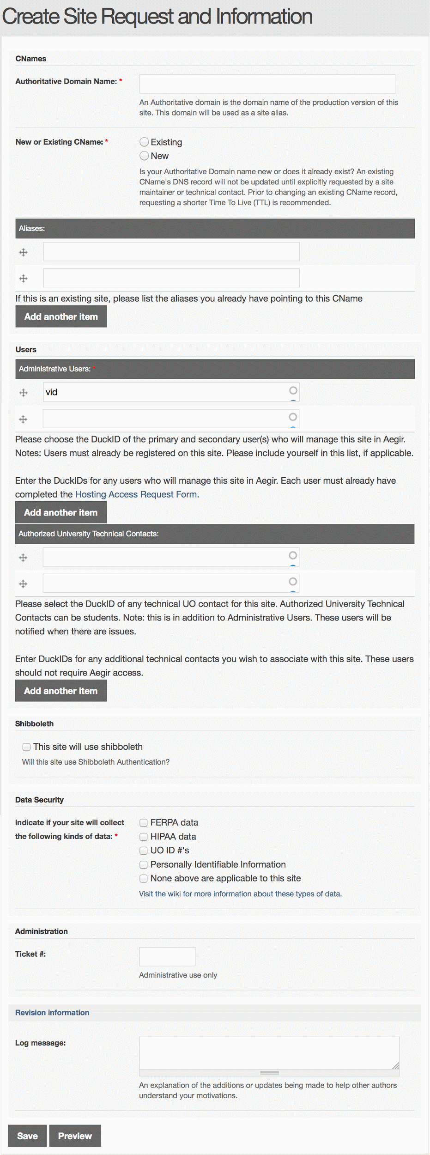
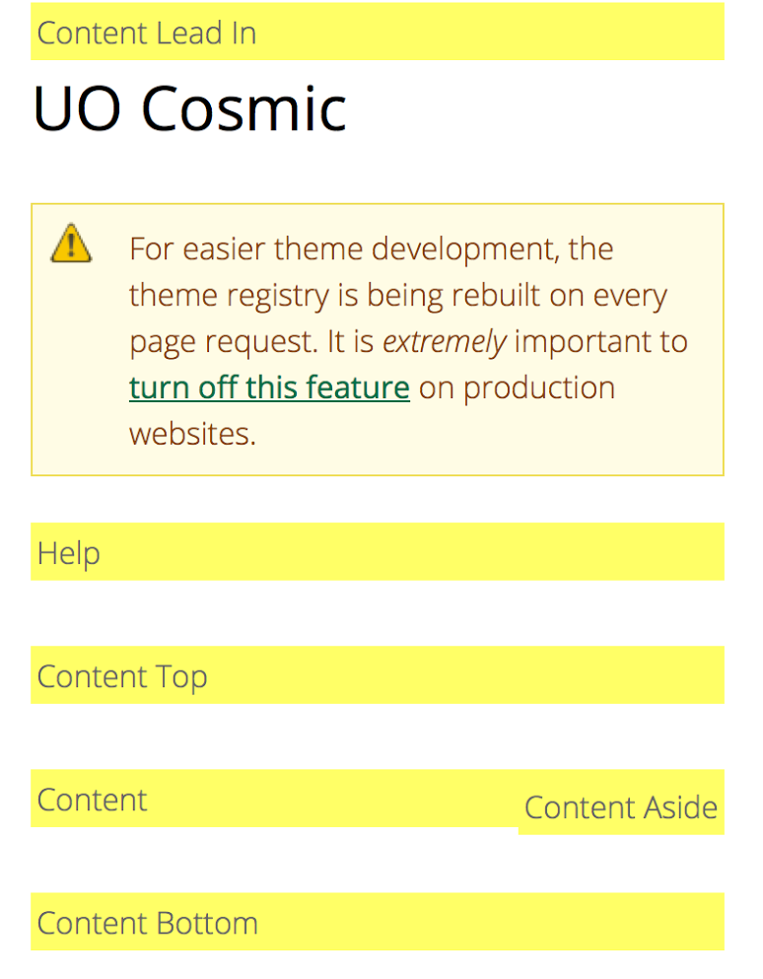
Walkthrough
Notes:
Vid is working on slideshow walkthrough - meanwhile, please enjoy this terrible placeholder slide.

Slide 18
Challenges
Asking departments to give up power
Providing support
Managing expectations
Implementing policy
Abandoned sites (developer leaves, slow to be replaced if ever)
Notes:
Department developers have no direct access under the hood (SSH, MySQL, Drush). Managers hate to give up seamless access to resources. In the past they haven't gotten as much responsiveness as they'd like from central IT so they can feel like relinquishing any kind of resource is a step backwards, when the real issue is they aren't adapting to changes in central and increased efficiency.
The steering committee had to support the developers and their sites and troubleshoot problems as they arise. Problems like failing to clone, launching the site in Aegir and so on.
Hard to figure out who’s problem it is when a site’s not working - is it the Aegir, is it our custom code, or is it their site?
Working with developers to use Drupal standards, helping them figure out why a module is not cloning or how to deploy contractor code into the system.
Department who can use this service are required by us to have a developer. We did that using policy. In reality we had to compromise,
Departments who either had a developer or used students to create their sites are now stuck with maintaining them and need a place to host them. We have to figure how to accommodate them and support their sites.
The other scenario is sites have moved in and were maintained till the developer left, now we have to work with the manager to figure out if they are going to get support and when that would happen (hiring can take a while). While they are hiring we have to do security updates and so on to keep their site going.
Next Slide

Slide 19
Challenges
Infrastructure Limitations
Security
High availability
Notes:
Waiting in line for your jobs to get done on busy days.
Shared infrastructure is a shared attack vector (Drupalgeddon) - are your neighbors patching?
DDoS (intentional or accidental) takes down everyone, not just the intended target
Related to the above, if a site/web node is taken down or compromised, we have to work with the developer to sort it out.
Who gets blamed? E.g if a site has no caching and it takes down the infrastructure because of accidental DDoS then we have to find out why and handle clients/developers complaining/expectations about the infrastructure when it is their site
Application is enormous and we’ve never done a dry run of restoring from backup.
Next Slide

Slide 20
Successes
Shared successes (more common code -> sometimes you get updates for free)
Shared Support and Resources
  Standardized platform (UO Vanilla)
  Shared Services
  SSL Certificates (wildcard)
  Domain Names (*.uoregon.edu and .org/.com)
  SSO (Shibboleth)
  LDAP Integration
  Load Balancing
  Git Hosting
  Monitoring
Notes:
This service has been a catalyst for increased community participation.
Look at all the cool toys you get for choosing to build a drupal site!
Next Slide

Slide 21
Successes
Backups
Security Patches (Drupalgeddon story time?)
Consolidation of VMs
Notes:
While we don’t really have full-scale disaster recovery, we do take site-level snapshots daily. If we need to we can recover a file, entire site and so on.
We have the capacity to apply critical security updates as a batch process, and we demonstrated this concept when Drupalgeddon hit.
We have a docker container that takes a backup and can spin up the site in development or wherever.
Many departments who had VMs were able to get rid of them when they moved over. This service does need a lot of VMs so it might be a wash but these VMs are now standardized and supported by the same group.
Next Slide

Slide 22
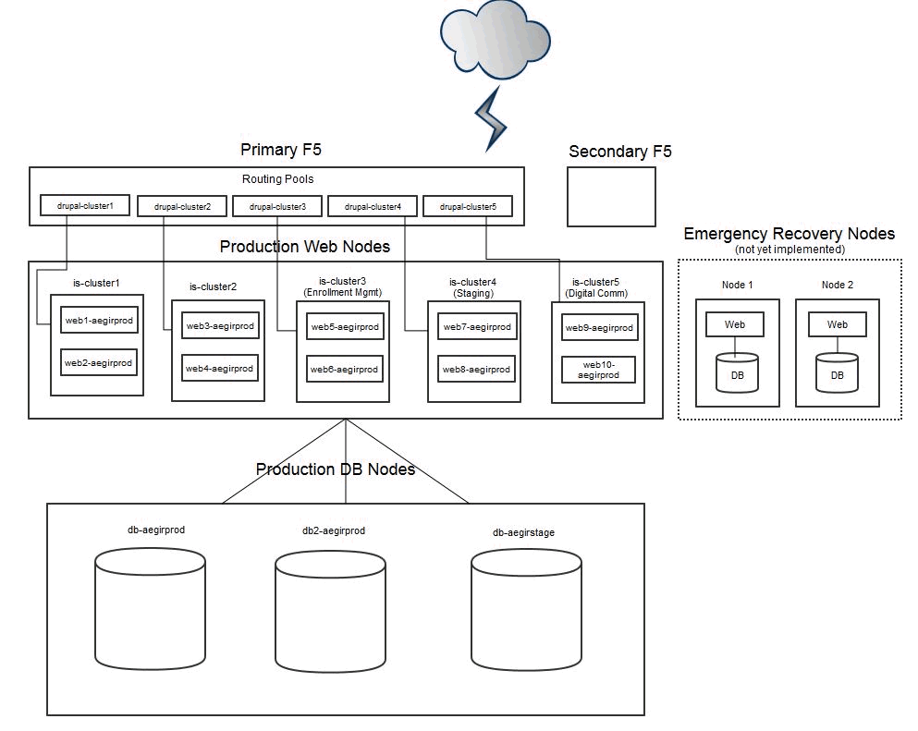
Infrastructure
Notes:
Daniel

Slide 23
Under the hood
Dev:
1 hostmaster node
4 web nodes (2 per pack)
2 db nodes
1 mgmt server
Test:
1 hostmaster node
4 web nodes (2 per pack)
2 db nodes
1 mgmt server
Prod:
1 hostmaster node
3 db nodes
10 web nodes (5 packs, 2 shared packs, 1 staging)
1 mgmt server
Memory: 3.7G
CPU
cpu family : 6
model : 37
model name : Intel(R) Xeon(R) CPU E5-2650 0 @ 2.60GHz
stepping : 1
microcode : 1805
cpu MHz : 2793.000
The size of the cpu seems to vary between web nodes.
Ex. cluster one has 2.0Ghz per node and cluster two has 2.6 and the staging cluster has 2.8
Files:
NFS Mounted file shares
Notes:
Mention? custom modules, views and patches along with a diff of UO Hosting vs standard hosting is relevant.

Slide 24
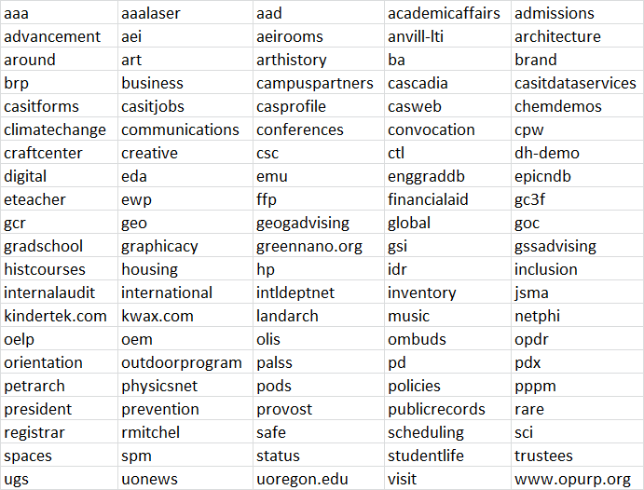
Current List of Participating Sites
[105 production sites] (*.uoregon.edu unless otherwise implied)
Notes:
Some of these sites are low traffic and some are high traffic, like homepage, admissions, registrar, schools.

Slide 25

Thank you
Questions?
Drupal Hosting Steering Committee Charter
Drupal Hosting Terms of Service
Steering Committee
Matt Coughlin - Finance and Administration
Jason Huebsch - Digital Communications
Daniel Mundra - Speaker, College of Arts & Sciences IT
Josh Rose - , formerly Student Life
Vid Rowan - Speaker, Human Resources
Jesse Sedwick - Information Services
Derek Wormdahl - Information Services

Slide 26
Acknowledgements
Max Bronsema - Western Washington University
Paul Kozik - Digital Communications
William Myers - formerly Interactive Media Group
Ed Parker - Digital Communications
Richard Silver - Human Resources
All the departments and developers at the University of Oregon who use our service and support our endeavor.
  18 Departments
  41 Web Developers

